Slide 1
E-Banking

Slide 2
E-Banking
Project Members
Anek Porwal (13W91A0509).
Manish Ambati (13W91A0508).
B. Aishwarya (13W91A0525).
Under Guidence of
- Mr. D Kalyan Kumar.

Slide 3
Abstract
This project aims at creation of a secure Internet banking system. This will be accessible to all customers who have a valid User Id and Password. This is an approach to provide an opportunity to the customers to have some important transactions to be done from where they are at present without moving to bank. In this project we are going to deal the existing facts in the bank i.e.; the transactions which takes place between customer and bank. We provide a real time environment for the existing system in the bank. We deal in the method transaction in the bank can be made faster and easier that is our project is an internet based computerized approach towards banking.

Slide 4
Existing System
Before going to replace or planning for a new system it is essential to have thorough knowledge about the existing system along with estimation or determination of how computers can be best used to make its operations more effective. System analysis is a process of collecting and interpreting facts, diagnosing problems and using the information to recommend improvements to the system. Accumulation of information about the existing system is called System Study. Basically, system analysis is about understanding situation, not solving problems

Slide 5
Existing System
Lack of Security.
Lots of PaperWork.
Lacking Efficiency.
No Self-User Creation.
Less Services Provided.
Profile Editing is time Consuming.

Slide 6
Proposed System
Understanding the problems & missing features of the existing system we have proposed a new system which implements the features missing in existing system & improving the efficiency of the existing system. The system requires very low system resources and the system will work in almost all configurations.

Slide 7
Proposed System
Increased level of Security by Providing Previous Logged in System IP Address.
SSL Protocol Used
One Way Encryption Using SHA-256.
Transaction History ( Long Period ).
Increased level of Efficiency by Coding Concerns.
Self-User Creation.
Transaction Service.
Cheque Book/Loan Request.
Profile Edit.

Slide 8
Architecture
Self-User Creation
Validation
Account Activation
Login
Authentication
View
Transaction
Cheque Book Request
Loan Request
Profile Edit
Transaction/Transfer Services
Logout

Slide 9
Modules
Account Summary
Transaction Activity Report
Fund Transfer
Check Request
Loan Request
Edit Profile
Change Password
Login
Self-User Creation

Slide 10
Security Enhancement
HTTPS PROTOCOL.
PASSWORD STORAGE USING ONE WAY ENCRYPTION.
PREVENTION FROM SQL INJECTION ATTACKS.
TRANSACTION PASSWORD FOR PERFORMING TRANSACTION.
PREVIOUSLY LOGGED IN SYSTEM IP ADDRESS.

Slide 11
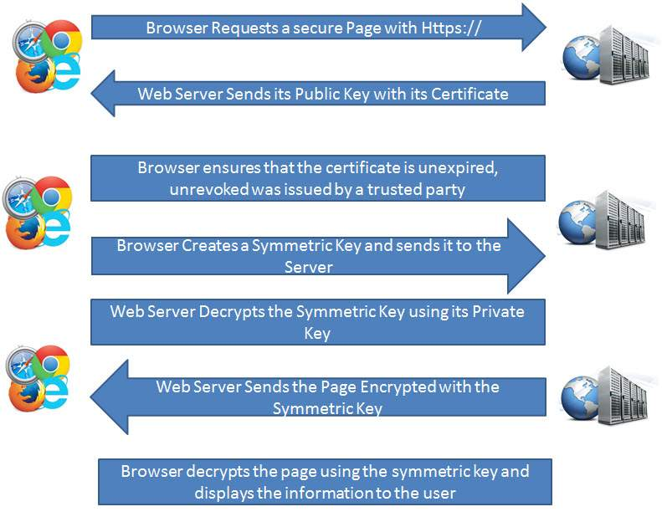
HTTP + SSL = HTTPS

Slide 12




ONE - WAY ENCRYPTION
WHY ONE WAY ENCRYPTION ?

Slide 13
Requirements
Software Requirements :
OS : Windows XP/7/8.1/10 OR Linux
Web Technologies : JSP, Java Beans, HTML, CSS, JS, Bootstrap Framework.
Server : Tomcat 8.0
Browser : Internet Edge/Google Chrome/Mozilla Firefox.
Database : MYSQL

Slide 14
Requirements
Hardware Requirements :
Processor : Pentium - III or above.
Speed : 1.6 GHz or above.
HDD : 40GB Hard Disk. (min.)
Ram : 1 GB or above. (min.)

Slide 15
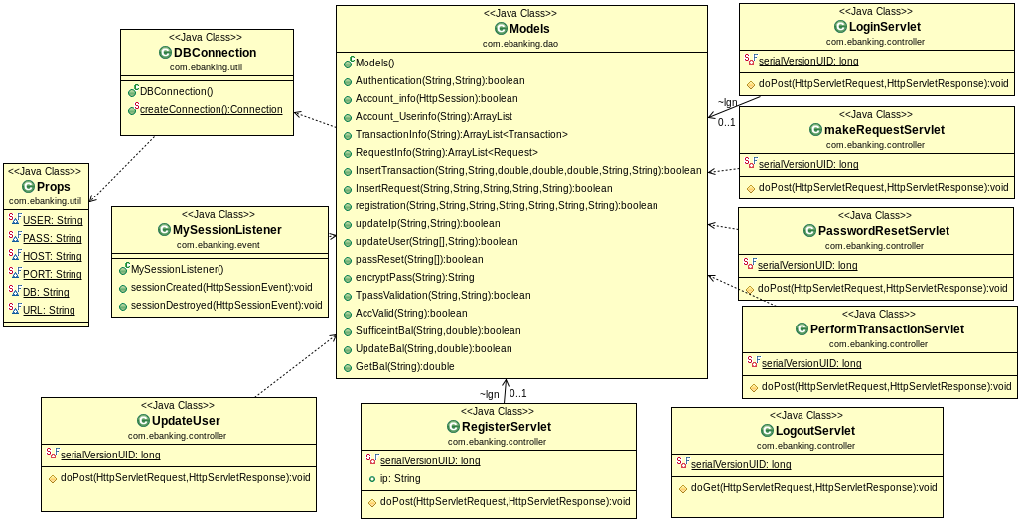
Class Diagram

Slide 16
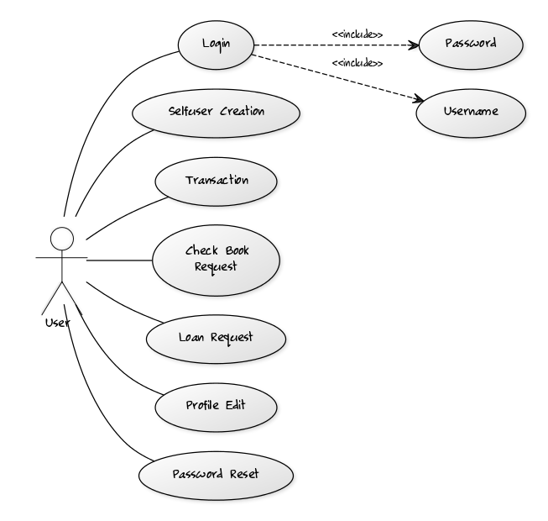
Use-Case Diagram

Slide 17
SEQUENCE DIAGRAM FOR REGISTERING AN ACCOUNT.
USER
DATABASE
Fill The Registration Form and Check for Validation
Validation Successful (Account No.)
Registration Successful

Slide 18
SEQUENCE DIAGRAM FOR TRANSACTION.
USER
DATABASE
Validate the Transaction Password
Validation Successful
Sufficient Amount Available In the Account
Validation Successful
Transaction Successful
Update Account Details in Database

Slide 19
Activity Diagram for User Login
Registered User
Enter
Login
Credentials
Is Valid
No
INVALID
Yes
Logged In

Slide 20
Activity Diagram for Transaction
Registered User
Login
Transaction Form
Trans.
Passworod Validatin
Yes
No
Sufficient Balance
Logged In
Yes

Slide 21
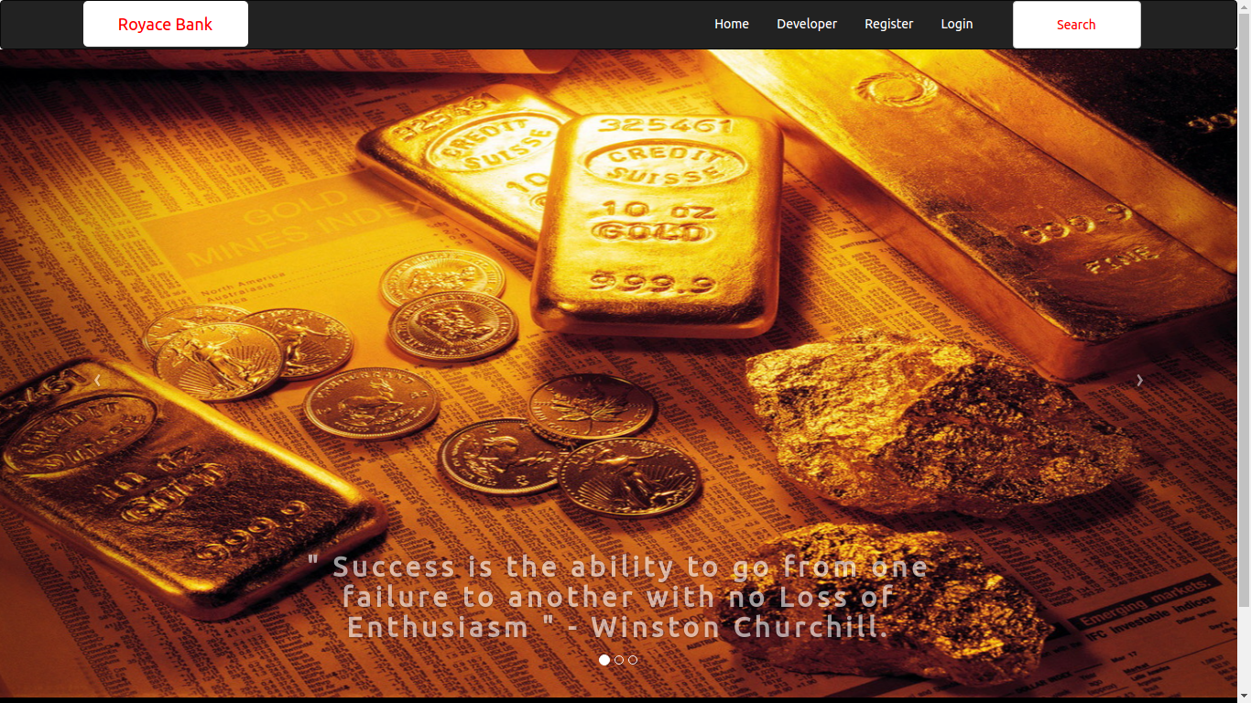
WELCOME PAGE OF ROYACE BANK

Slide 22
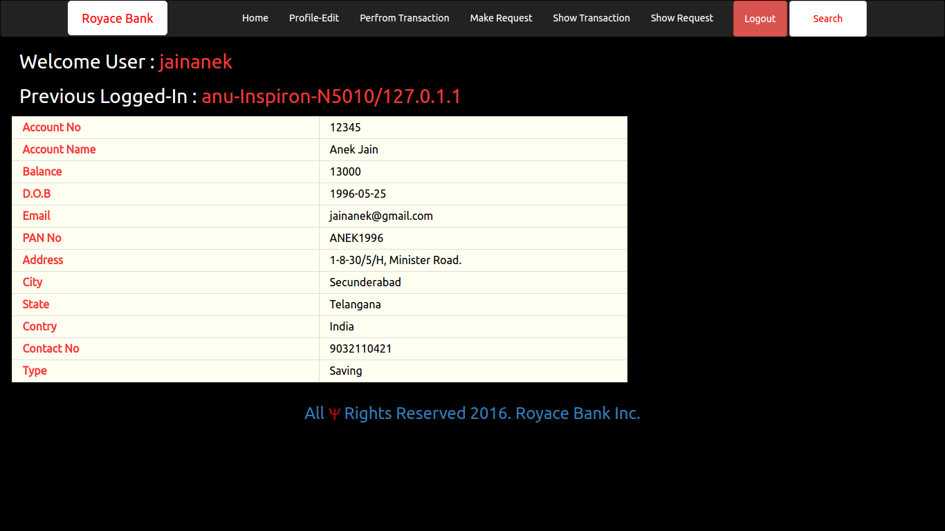
ACCOUNT DETAILS PAGE OF ROYACE BANK

Slide 23
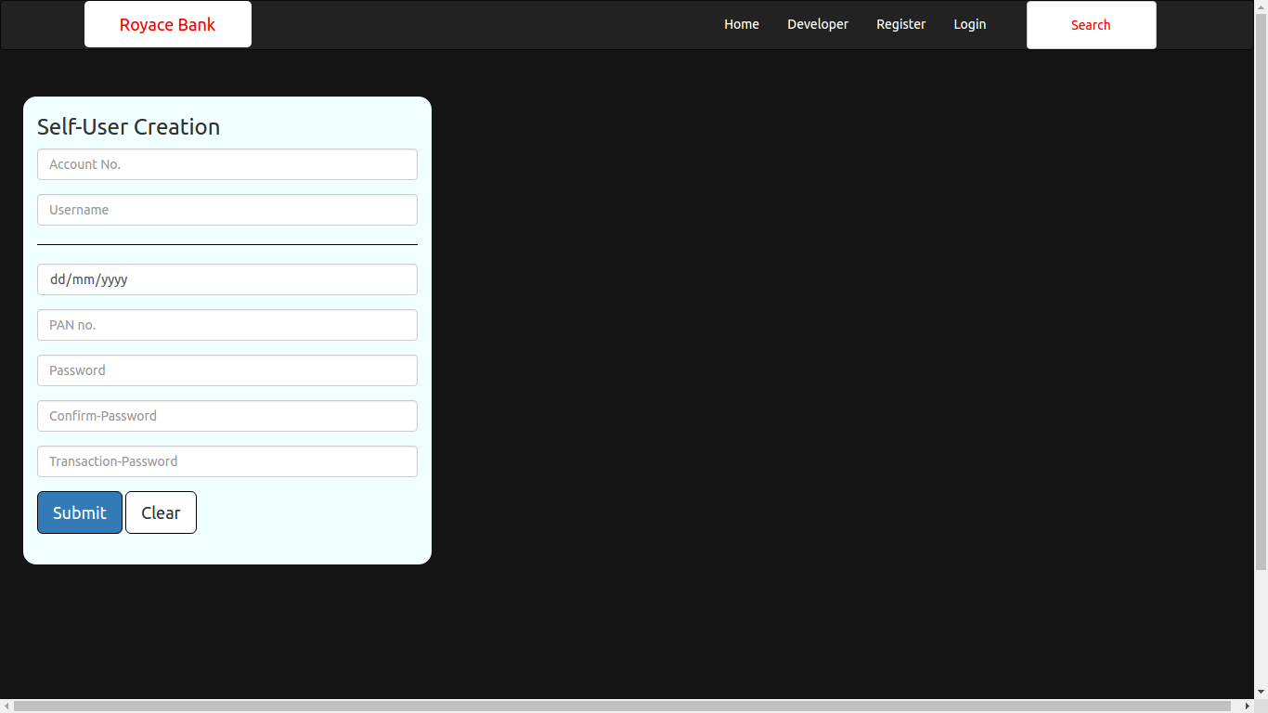
REGISTRATION PAGE OF ROYACE BANK

Slide 24
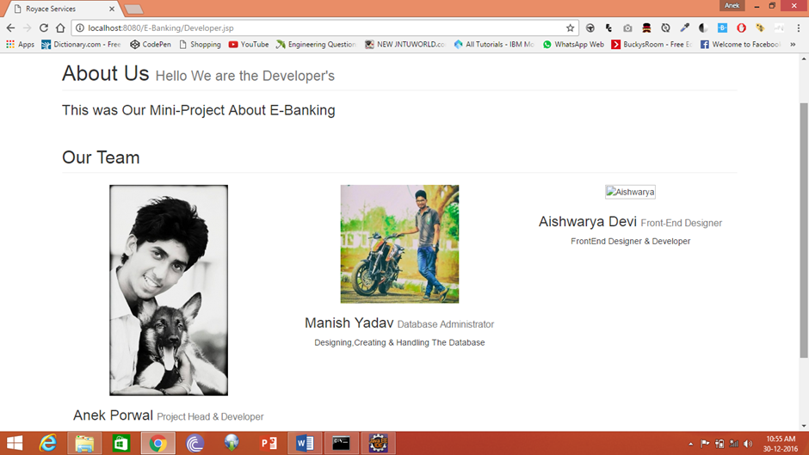
ABOUT US OF ROYACE BANK

Slide 25
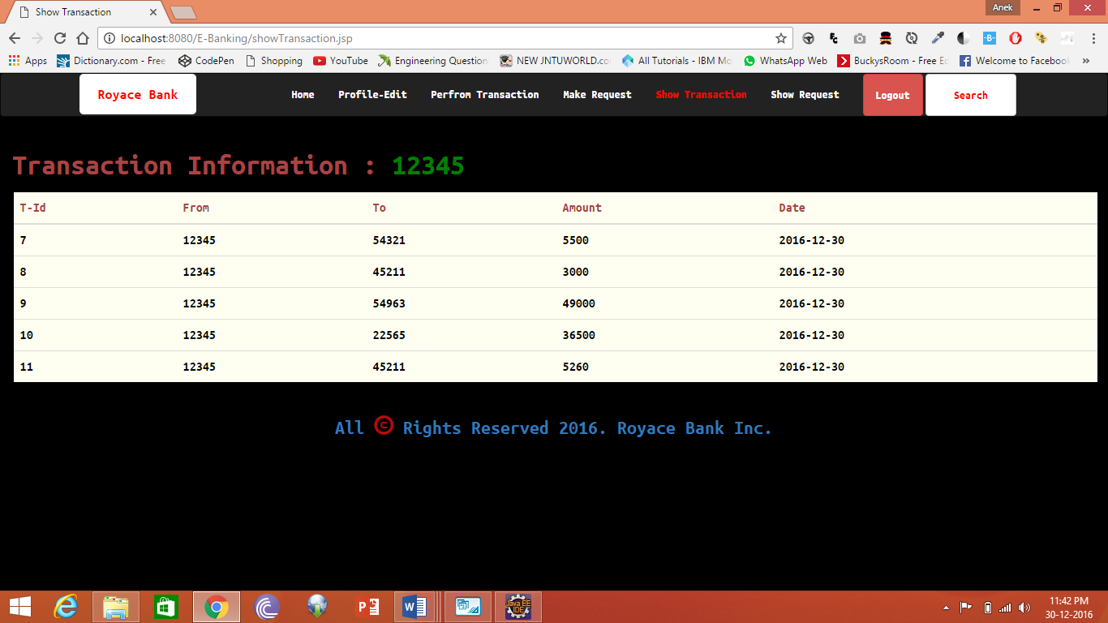
TRANSACTION PAGE OF ROYACE BANK

Slide 26
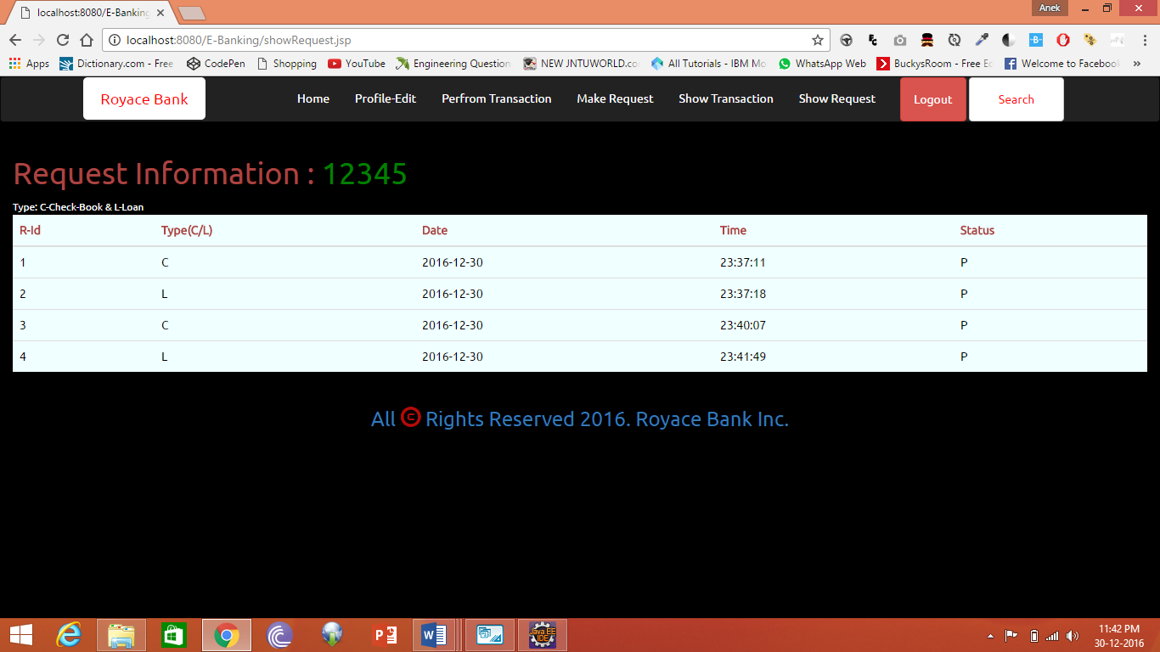
REQUEST PAGE OF ROYACE BANK

Slide 27
TESTING
Black-Box Testing:
The technique of testing without having any knowledge of the interior workings of the application is called black-box testing. The tester is oblivious to the system architecture and does not have access to the source code. Typically, while performing a black-box test, a tester will interact with the system's user interface by providing inputs and examining outputs without knowing how and where the inputs are worked upon.

Slide 28
TESTING
White-Box Testing:
White-box testing is the detailed investigation of internal logic and structure of the code. White-box testing is also called glass testing or open-box testing. In order to perform white-box testing on an application, a tester needs to know the internal workings of the code.

Slide 29
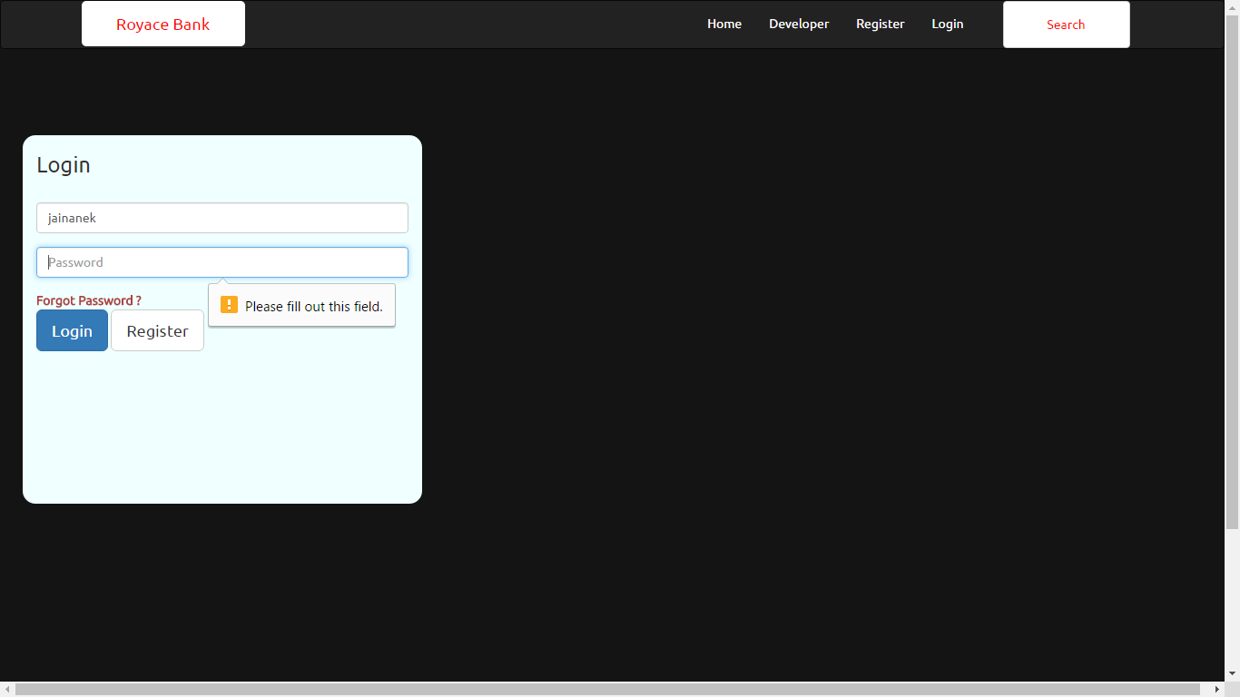
EMPTY PASSWORD USECASE

Slide 30
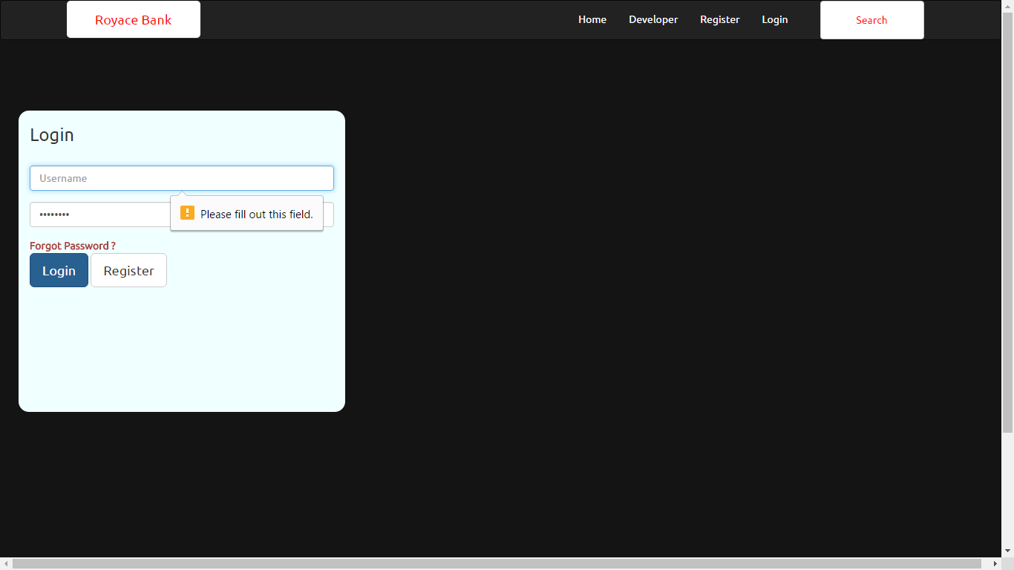
INVALID PASSWORD USECASE

Slide 31

INVALID CREDENTIALS USECASE

Slide 32
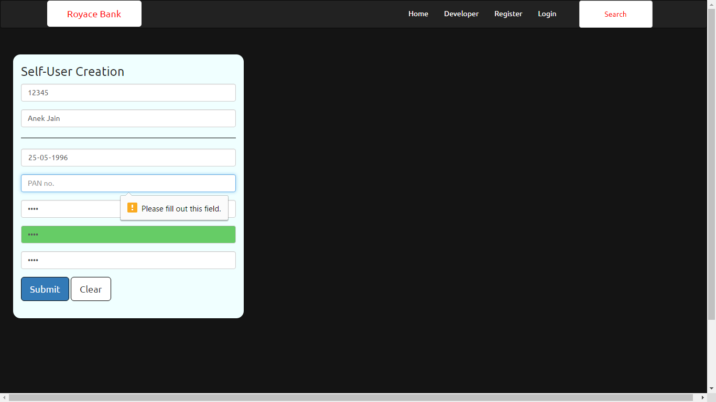
EMPTY PAN No. USECASE

Slide 33
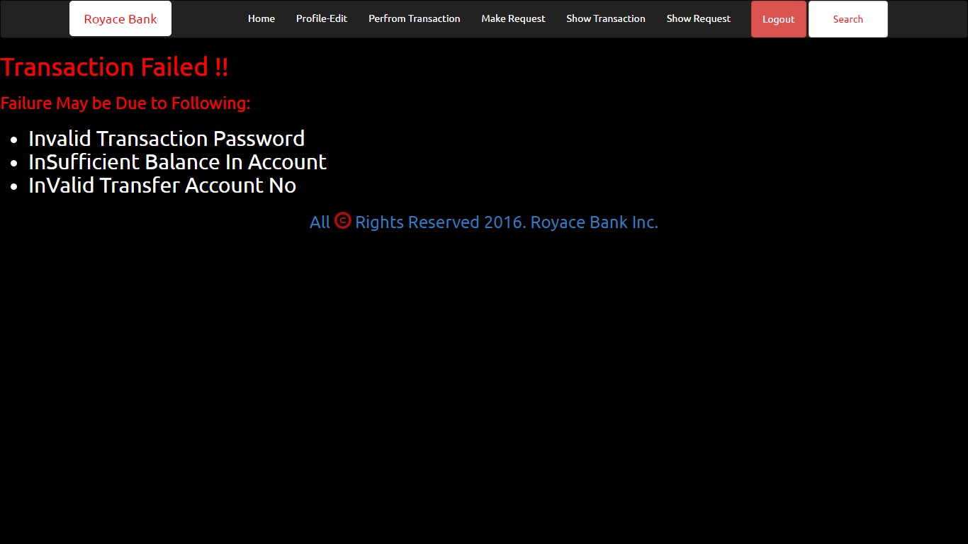
TRANSACTION INVAID USE CASE

Slide 34
REFERENCES
https://en.wikipedia.org/wiki/Online_banking
http://www.javatpoint.com/jsp-api
https://www.tutorialspoint.com/mysql/
https://en.wikipedia.org/wiki/Software_testing

Slide 35
THANK YOU.

